Slide 1
CodeCrunch (CS1020 AY2015/6 Sem 2)
Getting Started

Slide 2
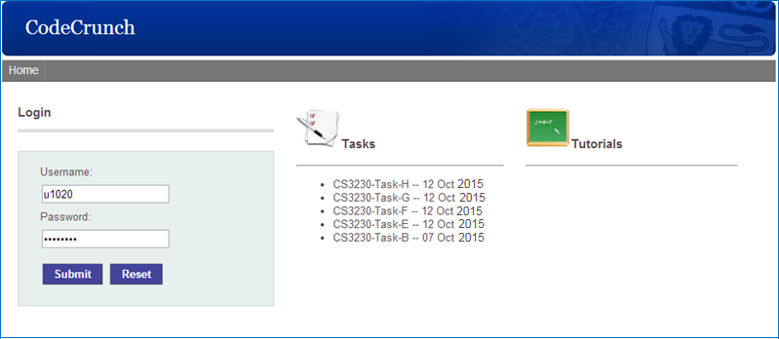
Logging in
Visit https://codecrunch.comp.nus.edu.sg/ using IE/Firefox/Chrome.
Use your NUSNET id and password to login.

Slide 3
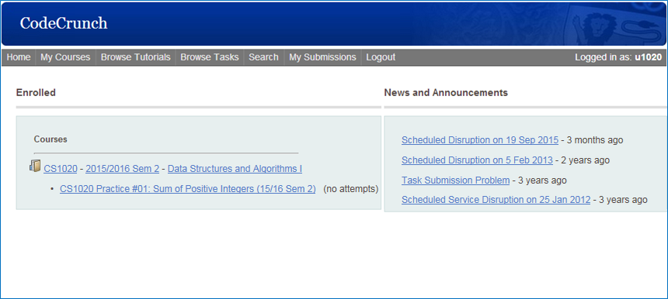
Selecting a task (1/3)
Click on the course name from dashboard.

Slide 4
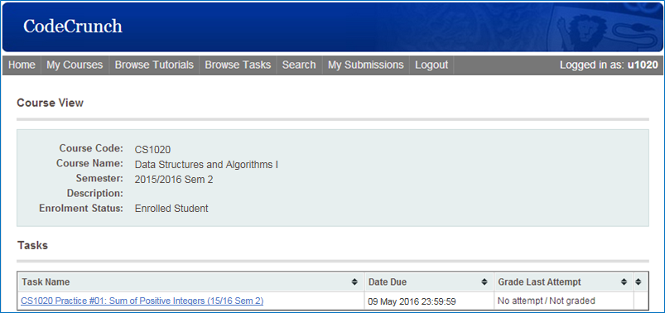
Selecting a task (2/3)
Click on the task name.

Slide 5
Selecting a task (3/3)
Shortcut for selecting an uncompleted task: Click on the task name from dashboard.
(Note: Only uncompleted tasks are shown on dashboard.)

Slide 6
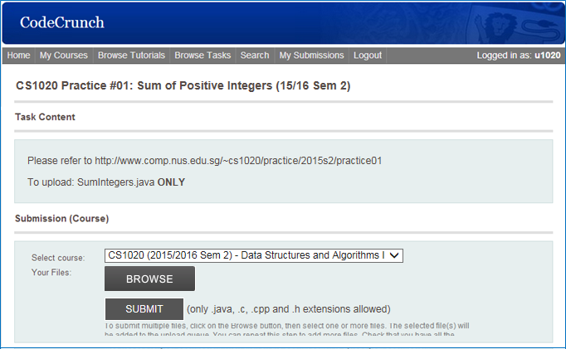
Solving a task
Follow the instructions in the Task Content section.
Write your program and test it thoroughly before submission.

Slide 7
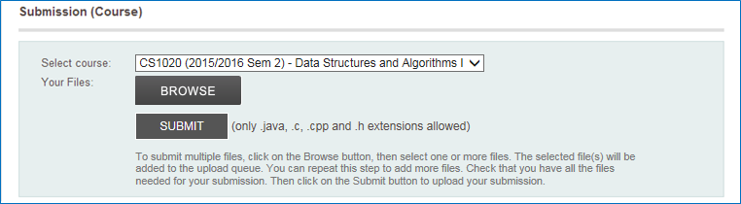
Submitting a task (1/3)
Once you are done, scroll down to the Submission (Course) section.
Click on Browse and select your solution program.
Take care to submit the correct file – some exercises have limited number of submissions.
Enable flashplayer for codecrunch website or you won’t be able to see the browse button !

Slide 8
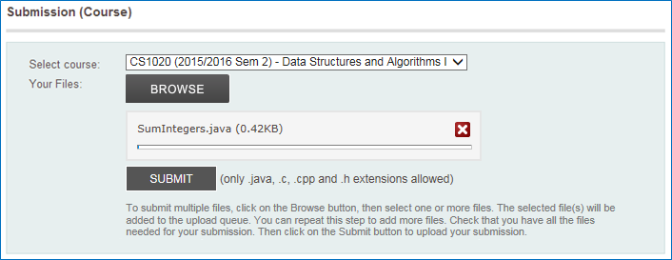
Submitting a task (2/3)
Wait for the loading box to appear.
Click on Submit.
The progress indicator may not move prior to clicking Submit.

Slide 9
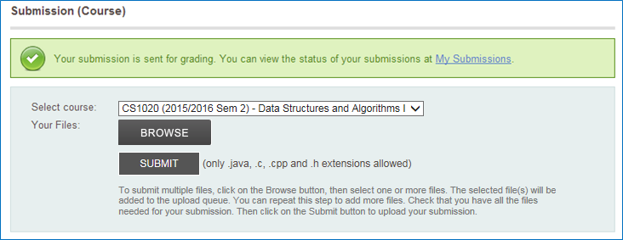
Submitting a task (3/3)
You should see a green box indicating that your program has been submitted successfully.
Click on My Submissions to see the grade awarded for that submission.

Slide 10
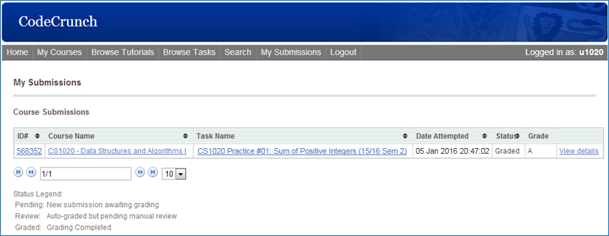
Reviewing a submission (1/3)
You should see the following table containing the details of your submission.
If you are awarded a grade of A, congratulations, you have passed CodeCrunch’s correctness test! (However, please read slide 13.)

Slide 11

Reviewing a submission (2/3)
If you did not succeed, click View details to check your output.

Slide 12
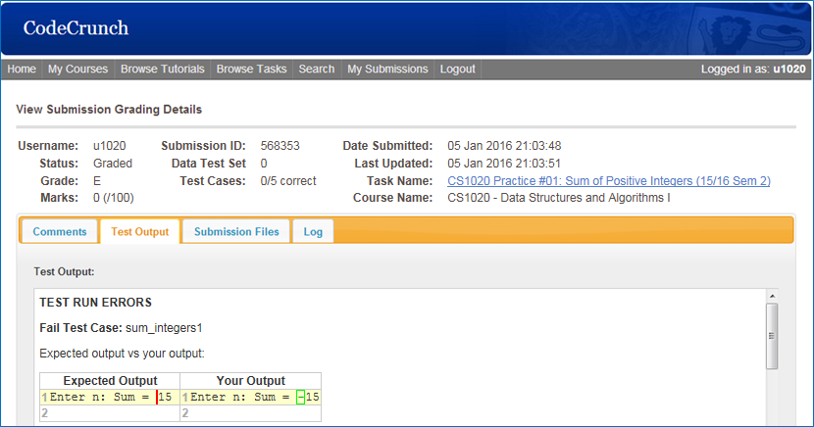
Reviewing a submission (3/3)
Check the Test Output tab for the difference between the expected output and your output.
What’s wrong with this output?

Slide 13
THE END

